Slide 1


Slide 2
Implementation Classification

Slide 3
Classification
Classification is the process of recognizing, understanding, and grouping ideas and objects into preset categories or “sub-populations.”
Using pre-categorized training data-sets, machine learning programs use a variety of algorithms to classify future data-sets into categories.

Slide 4
Classification
Classification is the process of predicting the class of given data points.
Classes are sometimes called as targets/ labels or categories.
Classification predictive modeling is the task of approximating a mapping function (f) from input variables (X) to discrete output variables (y).

Slide 5
Classification
Classification belongs to the category of supervised learning where the targets also provided with the input data.
There are many applications in classification in many domains such as in credit approval, medical diagnosis, target marketing etc.

Slide 6
Classification Algorithms
Logistic Regression
Naive Bayes Classifier
K-Nearest Neighbors
Decision Tree
Random Forest
Support Vector Machines

Slide 7
Confusion Matrix
A Confusion matrix is an N x N matrix used for evaluating the performance of a classification model, where N is the number of target classes.
The matrix compares the actual target values with those predicted by the machine learning model.
This gives us a holistic view of how well our classification model is performing and what kinds of errors it is making.

Slide 8
Confusion Matrix
True Positive
True Negative
False Positive – Type 1 Error
False Negative – Type 2 Error

Slide 9
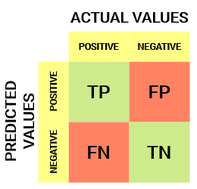
Confusion Matrix

Slide 10
Confusion Matrix
True Positive (TP)
The predicted value matches the actual value
The actual value was positive and the model predicted a positive value
True Negative (TN)
The predicted value matches the actual value
The actual value was negative and the model predicted a negative value

Slide 11
Confusion Matrix
False Positive (FP) – Type 1 error
The predicted value was falsely predicted
The actual value was negative but the model predicted positive value
False Negative (FN) – Type 2 error
The predicted value was falsely predicted
The actual value was positive but the model predicted negative value

Slide 12
Thanks

